Slide 1




Telecom Customer Churn Prediction
Presented by:
Name: Sandip Ramcharit Verma
PRN: 20240804044
Dr. Jagadish S Jakati
Project Guide
Dr. Swapnil Waghmare
Project Coordinator
Dr. Maheshwari Biradar
HOD, BCA&MCA

Slide 2

Content
Introduction
Problem Statement
Objectives
Literature Review
Existing Research & Approaches
Outcome from Review
Proposed Methodology
Project Workflow Overview
Tools & Technologies Used
System Design
Data Flow Diagrams
Flowchart
Block Diagram
Activity Diagram
Model Building
Model Evaluation
Model Performance
Confusion Matrix
Ensemble Learning
Model Deployment
Conclusion & Future Scope

Slide 3

Introduction
Customer churn is a major issue in the telecom industry, where customers discontinue using services, leading to revenue loss and increased marketing costs. By using machine learning techniques, companies can analyze customer behavior and predict churn. This helps in taking early actions to improve retention and business performance.
Problem Statement:
Telecom companies face difficulty keeping customers.
High competition increases risk of losing them.
Hard to know in advance who will churn.
Need an intelligent system to predict churn and support timely action.
Objectives:
Develop a predictive model to identify customers at risk of churning.
Enable telecom companies to take proactive retention measures.
Provide real-time and batch churn prediction through a user-friendly interface.

Slide 4
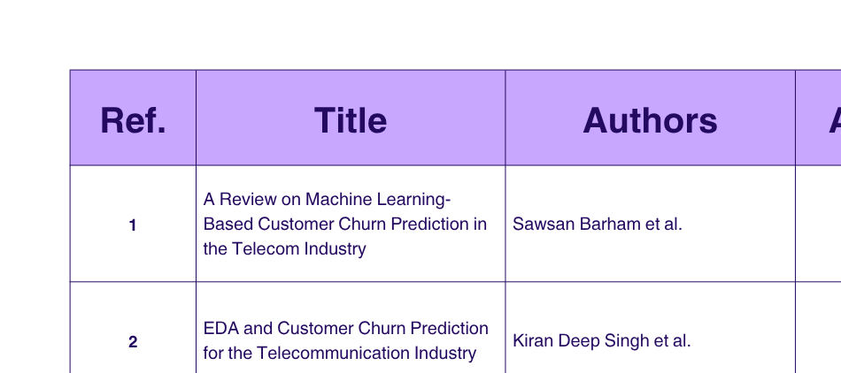
Literature Review
Existing Research & Approaches:

Slide 5
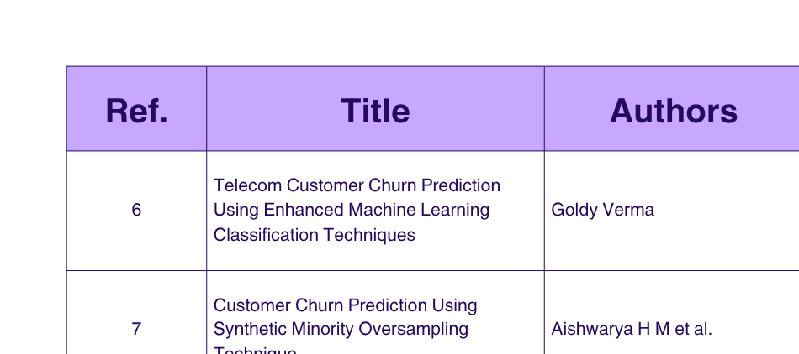

Slide 6
Outcome from Review:
Data preprocessing, feature selection, and class balancing are important steps.
SMOTE helps fix class imbalance for better results.
Common models: Decision Tree, Random Forest, KNN, Logistic Regression, SVM, and XGBoost.
Ensemble methods (Voting Classifier) improves accuracy and stability.
Hyperparameter tuning using GridSearchCV improves model efficiency.
Metrics like Accuracy, Precision, Recall, and F1-Score are key for evaluation.
Combining multiple models can produce more reliable predictions.

Slide 7
Proposed Methodology
Project Workflow Overview:
Collected and explored telecom customer data.
Dropped missing values and cleaned the dataset.
Encoded categorical data and scaled numeric features.
Applied SMOTE to balance the dataset due to class imbalance.
Built and trained various machine learning models:
Decision Tree, Random Forest, KNN, Logistic Regression, SVM, XGBoost
Tuned hyperparameters using GridSearchCV for better accuracy.
Combined top-performing models using a Voting Classifier.
Evaluated models using Accuracy, Precision, Recall, and F1-Score.
Deployed final model using Streamlit for real-time and batch churn prediction.

Slide 8
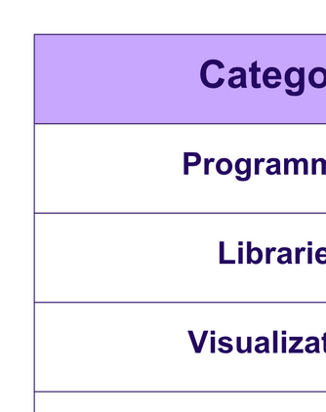
Tools & Technologies Used:

Slide 9
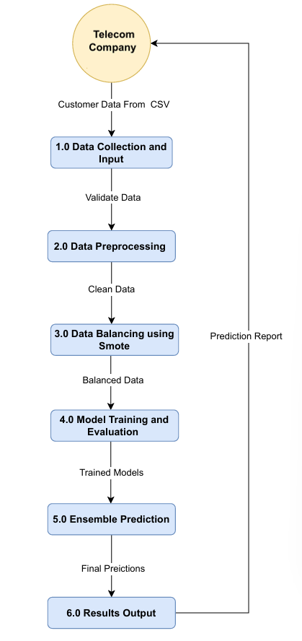
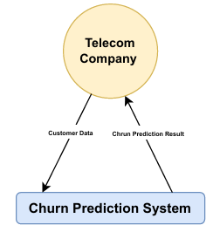
System Design
Data Flow Diagrams:
Level 0 DFD
Level 1 DFD

Slide 10

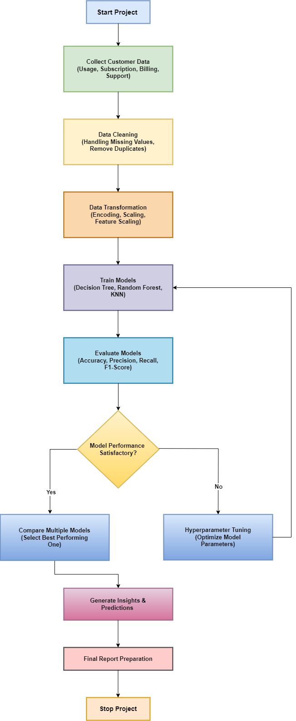
Flowchart:
A
A

Slide 11
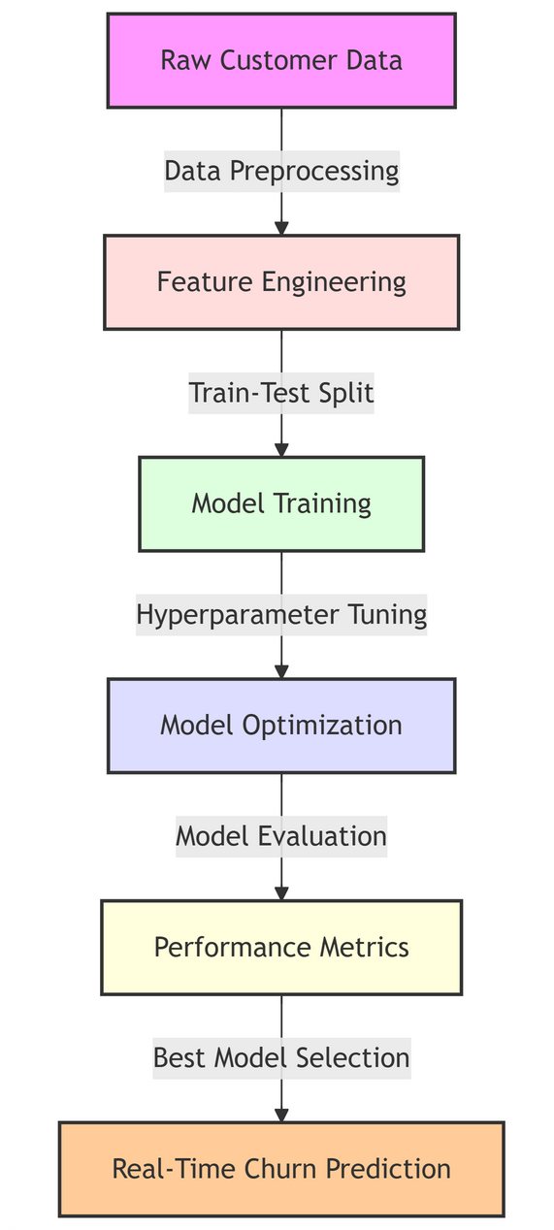
Block Diagram:

Slide 12
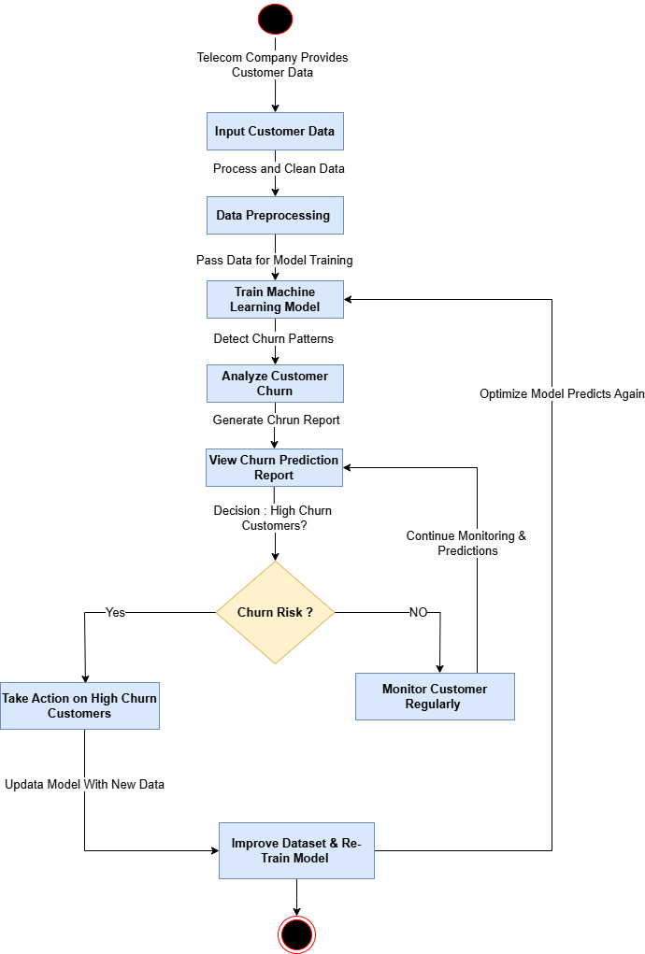
Activity Diagram:

Slide 13
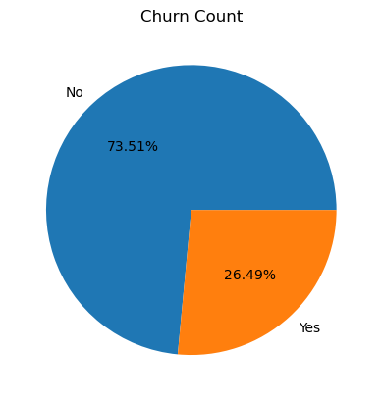
Churn Count:

Slide 14
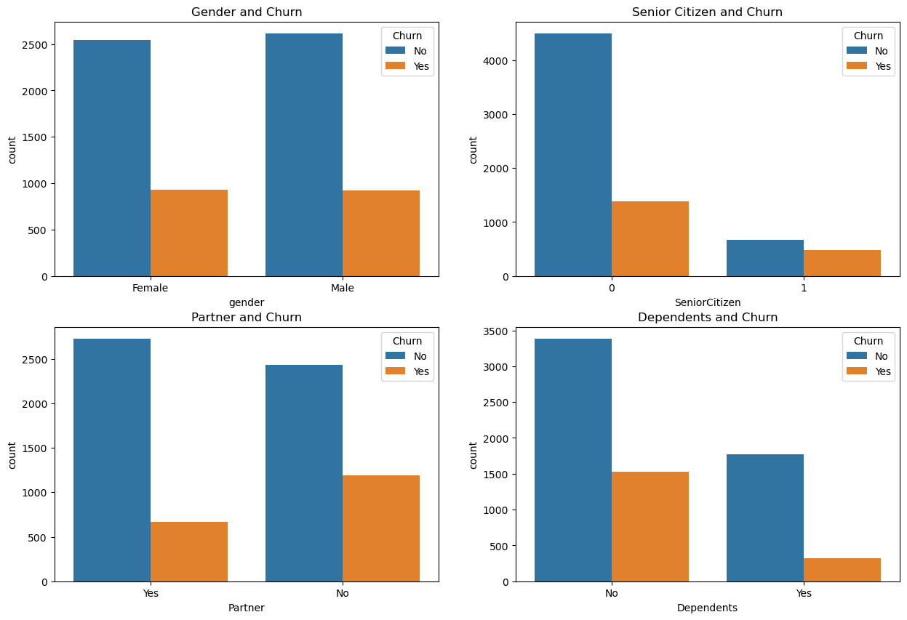
Customer Demographics and Churn:

Slide 15
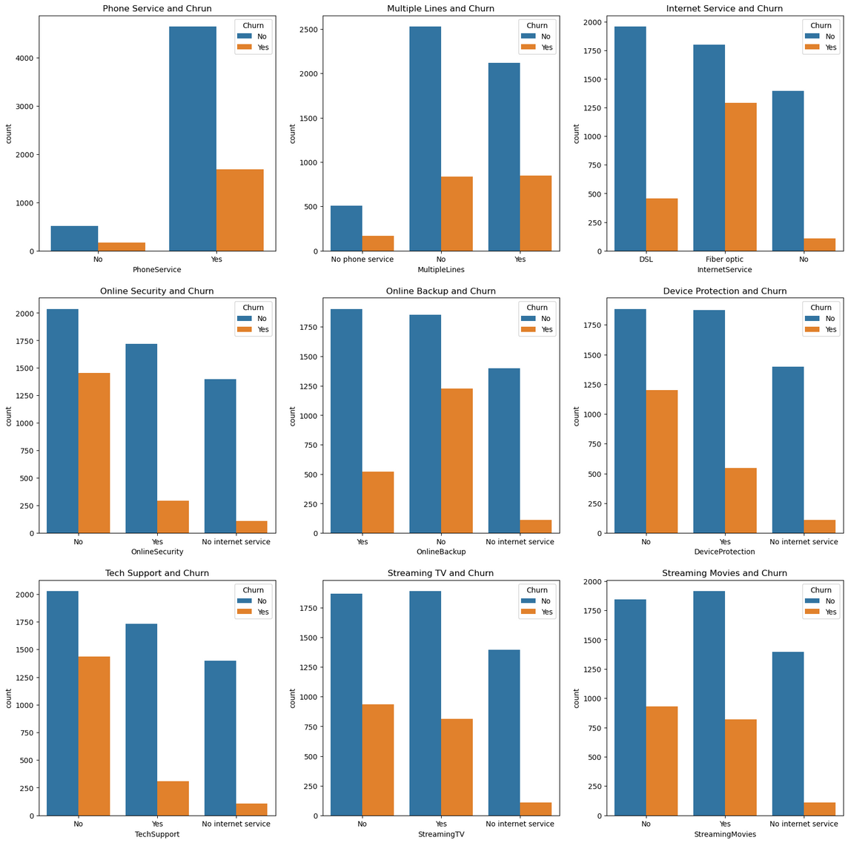
Services and Churn:

Slide 16
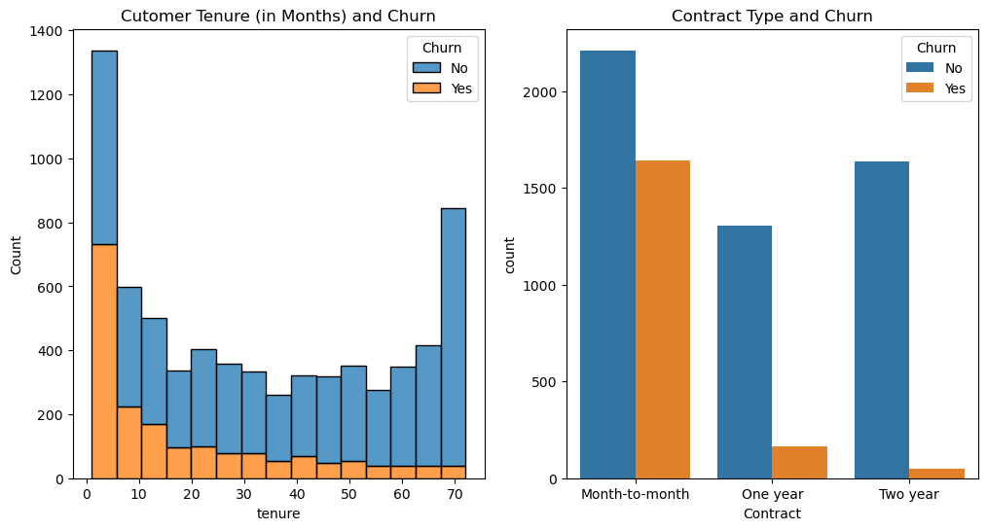
Tenure/Contract and Churn:

Slide 17
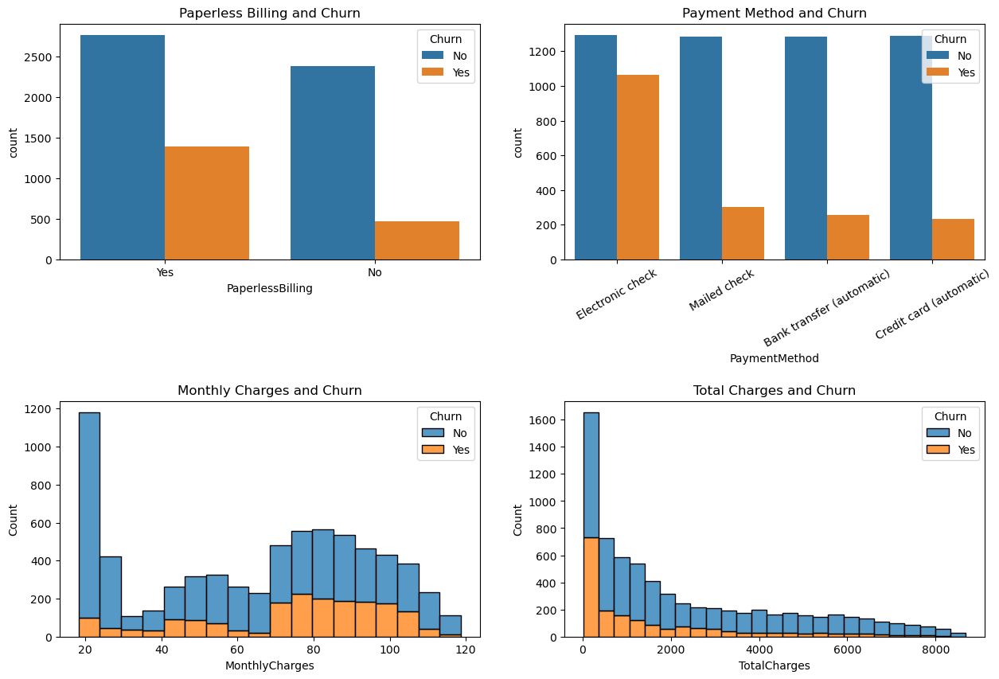
Charges and Churn:

Slide 18
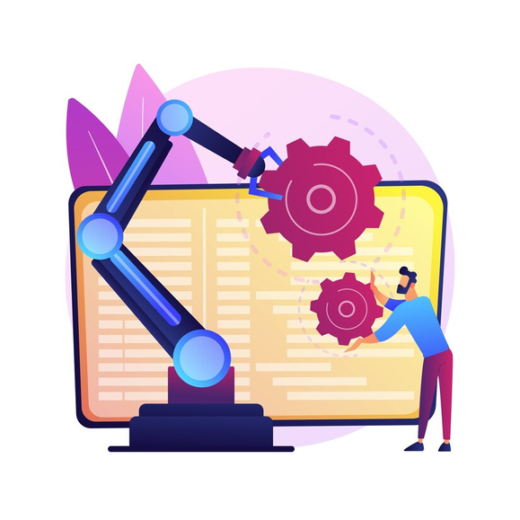
Model Building
Models Implemented:
Decision Tree Classifier:
Simple, interpretable model that splits data based on rules.
Random Forest Classifier:
Ensemble of decision trees that reduces overfitting and improves accuracy.
K-Nearest Neighbors (KNN):
Distance-based model that predicts based on nearest samples.
Logistic Regression:
Binary classification problems.
Support Vector Machine (SVM):
Finds the optimal hyperplane to separate churn vs non-churn.
XGBoost Classifier:
Efficient gradient boosting algorithm known for high performance.
Model Training Process:
Split data into training (80%) and testing (20%) sets.
Applied SMOTE to balance the training data.
Trained each model on the preprocessed data.
Used GridSearchCV to perform hyperparameter tuning for optimal performance.
Selected top 4 models based on evaluation scores for ensemble learning.

Slide 19
Model Evaluation
Model Performance:
Model | Train Accuracy | Test Accuracy | Precision (Class 0) | Recall (Class 0) | F1-Score (Class 0) | Precision (Class 1) | Recall (Class 1) | F1-Score (Class 0)
Decision Tree | 83.48% | 76.89% | 0.86 | 0.83 | 0.84 | 0.56 | 0.61 | 0.58
Random Forest | 87.44% | 78.53% | 0.86 | 0.84 | 0.85 | 0.59 | 0.63 | 0.61
K-Nearest Neighbors | 89.17% | 75.18% | 0.82 | 0.84 | 0.83 | 0.53 | 0.50 | 0.52
Logistic Regression | 80.31% | 77.38% | 0.87 | 0.81 | 0.84 | 0.56 | 0.66 | 0.61
Support Vector Machine | 83.28% | 77.88% | 0.86 | 0.83 | 0.85 | 0.57 | 0.63 | 0.60
XGBoost | 87.26% | 77.81% | 0.86 | 0.83 | 0.85 | 0.57 | 0.63 | 0.60

Slide 20
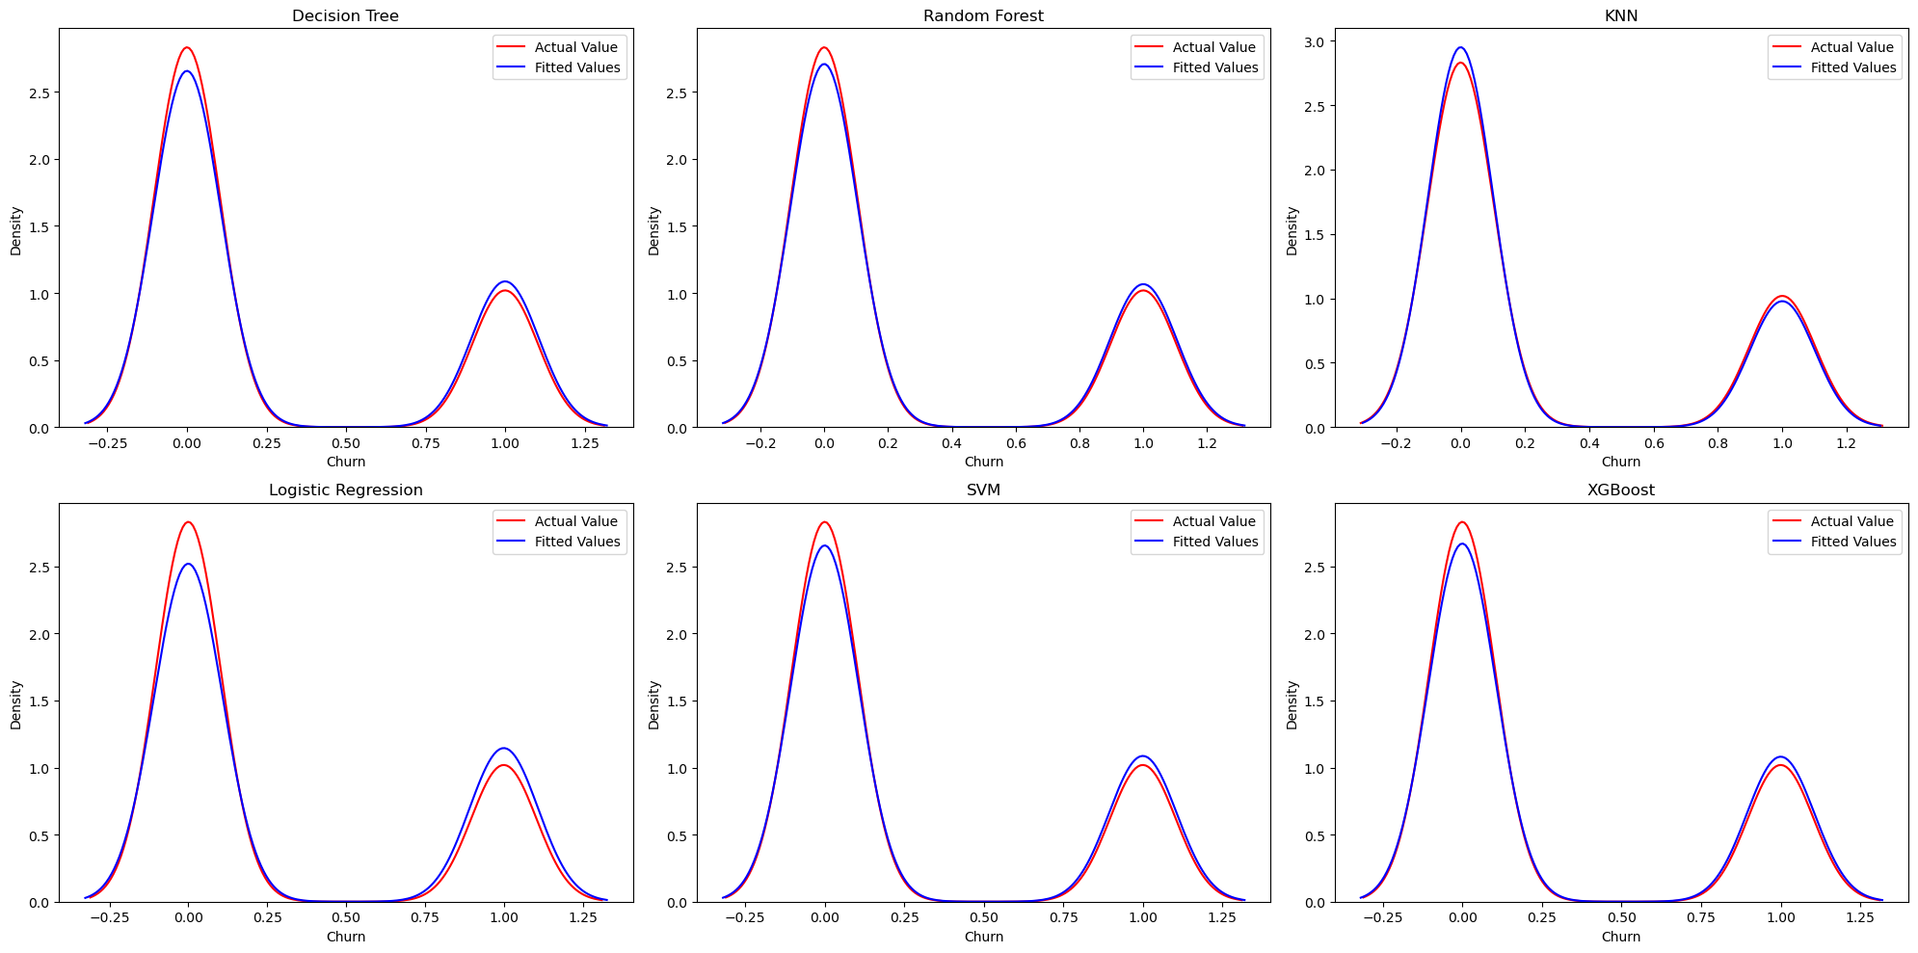
Distribution plot of predicted vs actual values for all models

Slide 21
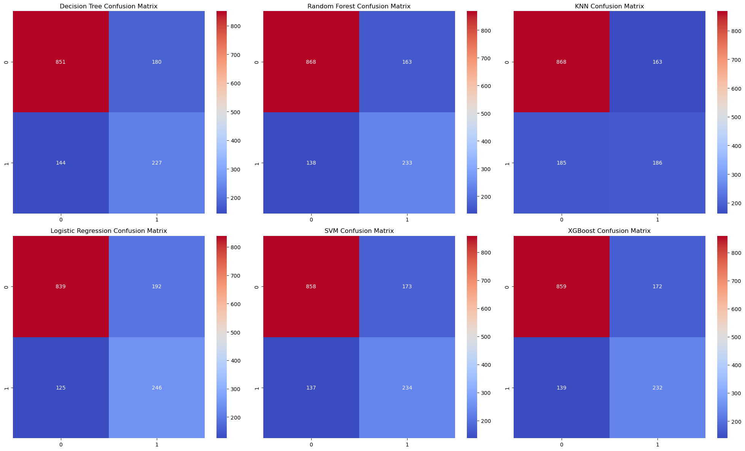
Confusion Matrix:
0 1031
1 371

Slide 22
Ensemble Learning – Voting Classifier:
Model | Reason for Inclusion
Random Forest | Highest accuracy and balanced performance
XGBoost | Strong with imbalance, captures complex patterns
SVM | Reliable
Logistic Regression | Highest recall for churners
Performance
Training Accuracy: 84.37%
Testing Accuracy: 78.39%
Confusion Matrix:
[ 868 163
140 231 ]

Slide 23
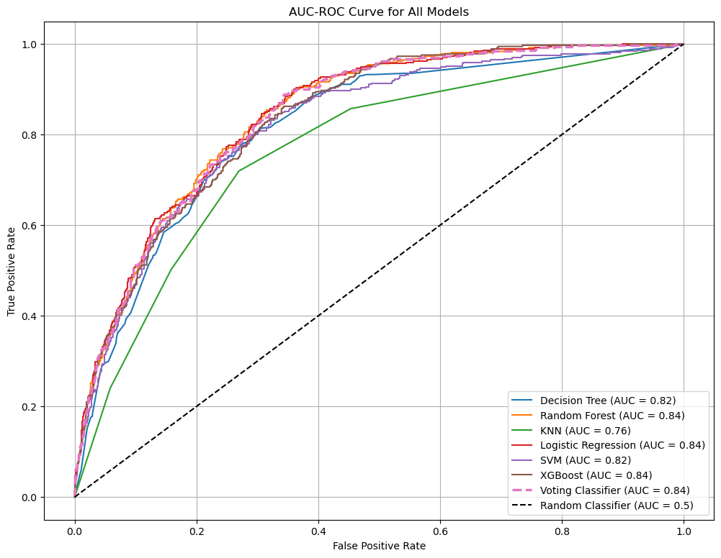
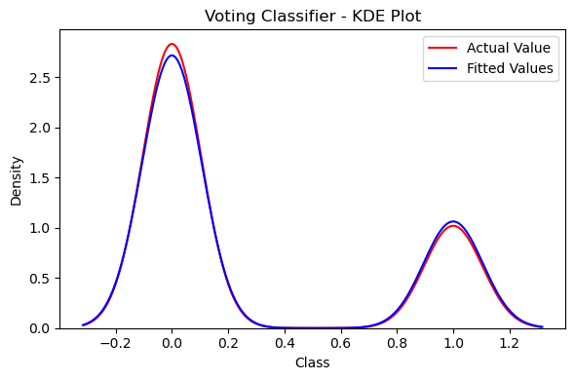

Slide 24
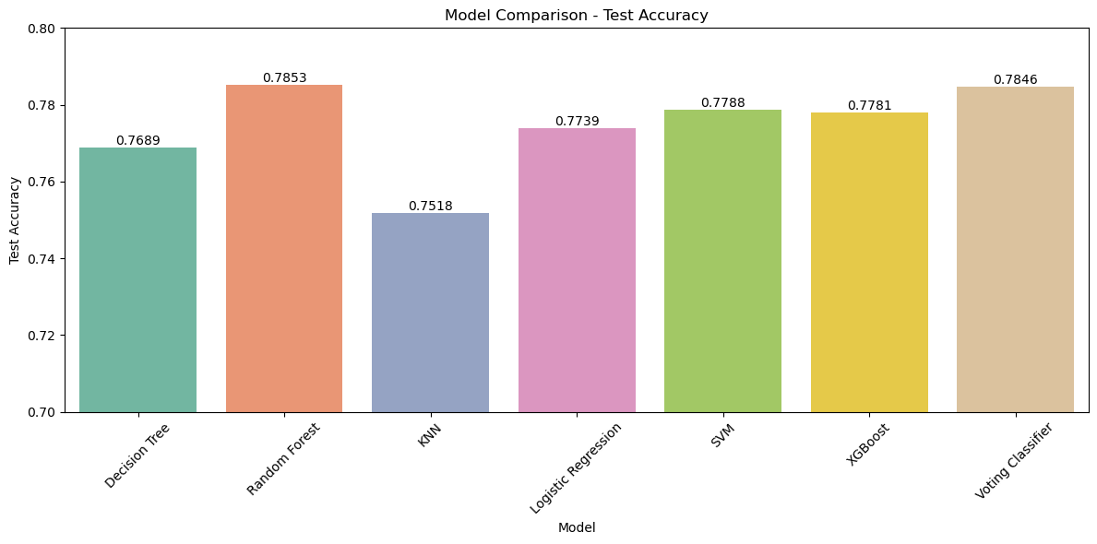
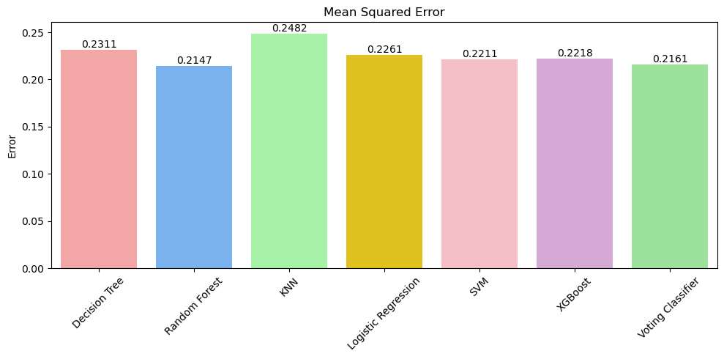

Slide 25
Model Deployment
To make the churn prediction system accessible and usable, the final model was deployed using Streamlit, a powerful and lightweight Python web framework.
App Features
Churn Prediction: Input customer details and get real-time churn prediction.
Prediction Logs: View and track past predictions made through the app.
Batch Prediction: Upload CSV files to predict churn for multiple customers at once.
Model Explanation: Understand how the model makes predictions using key features.
About Page: Project overview and developer information.
Tech Stack
Frontend: Streamlit (Python)
Backend:
Model Serialization: joblib used to save and load models
voting_classifier_model.joblib
random_forest_model.joblib
label_encoders_dict.joblib
standard_scaler.joblib
feature_order.joblib

Slide 26
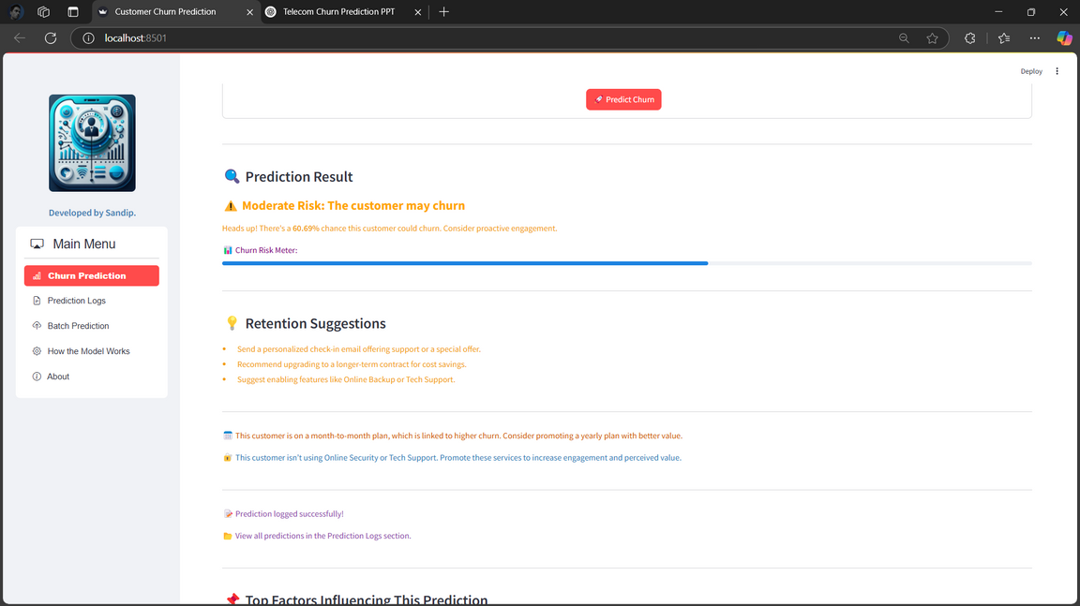
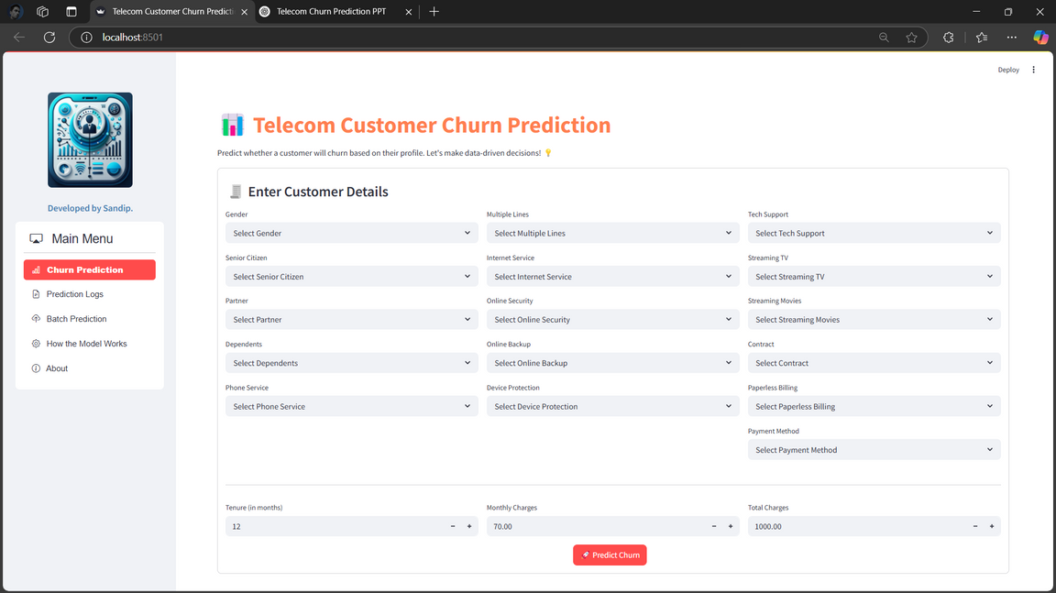
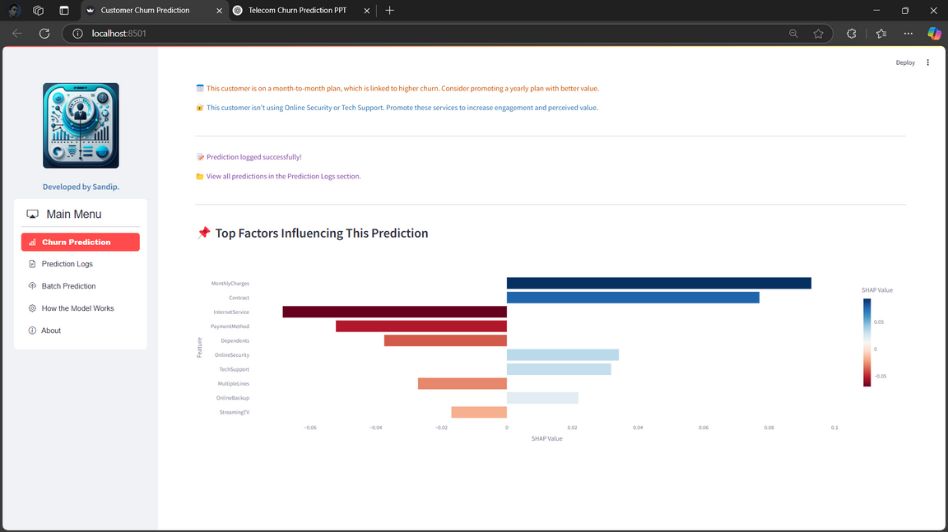
Churn Prediction:
Used for real-time single-customer churn prediction.

Slide 27
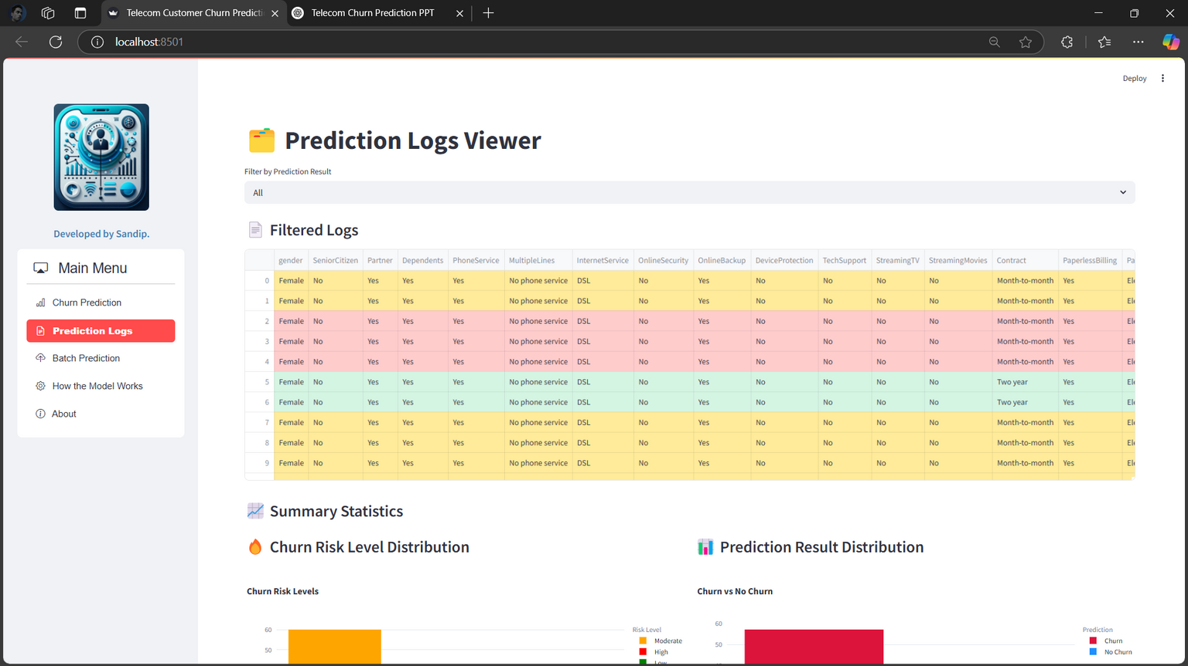
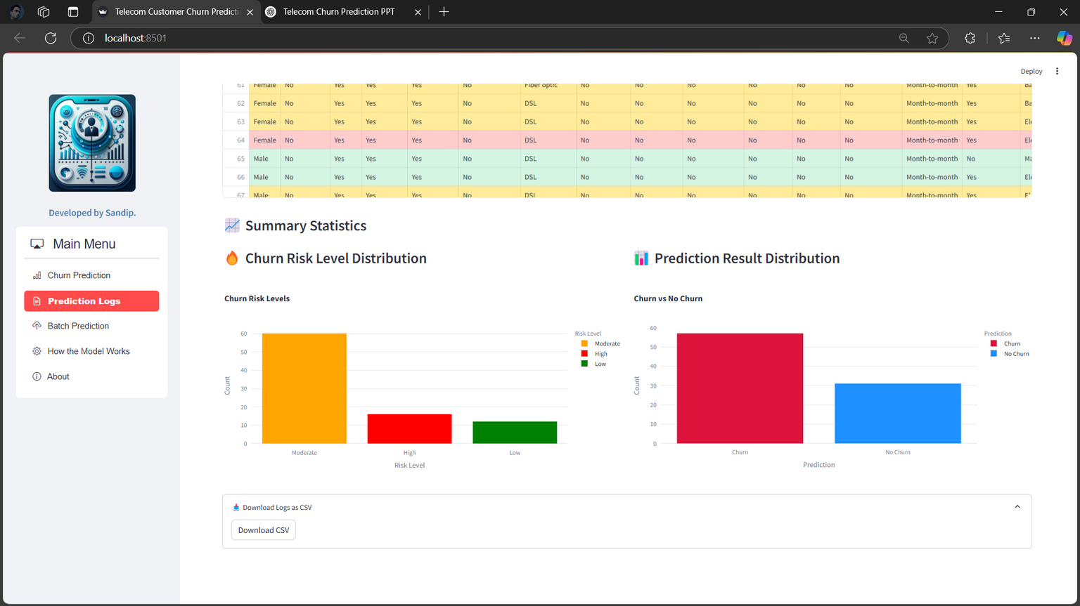
Prediction Logs:
Tracks and displays historical churn predictions.

Slide 28
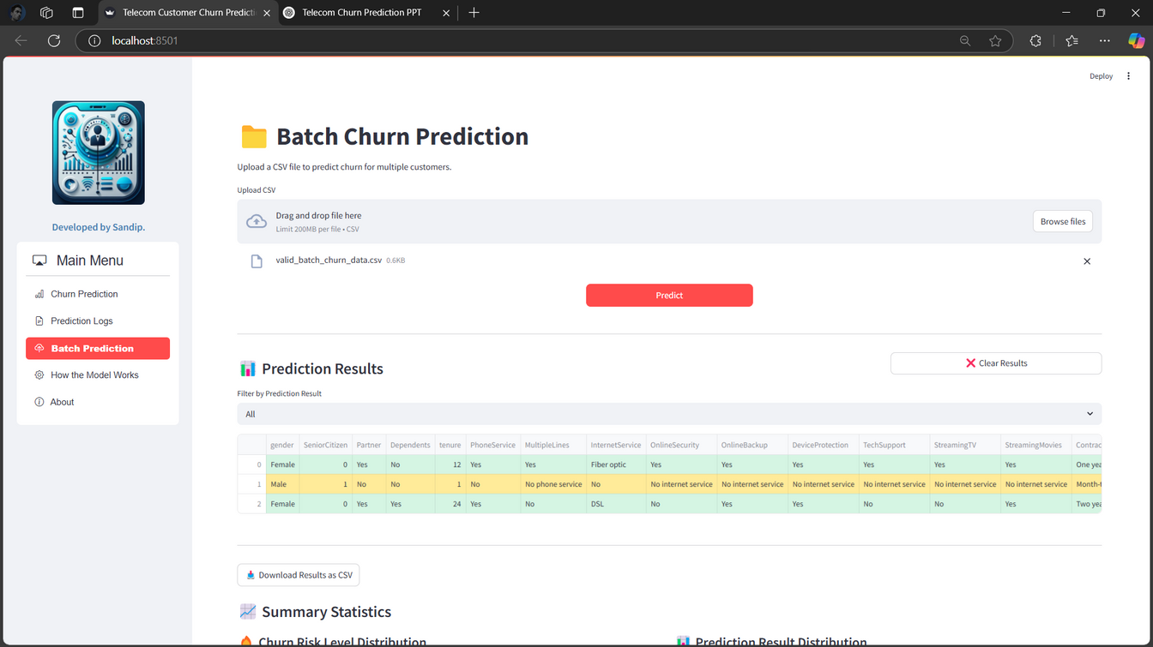
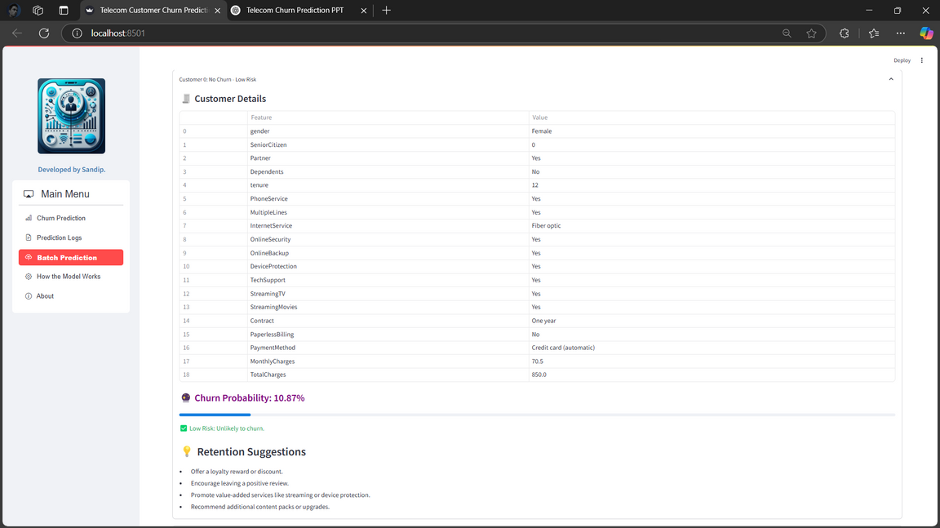
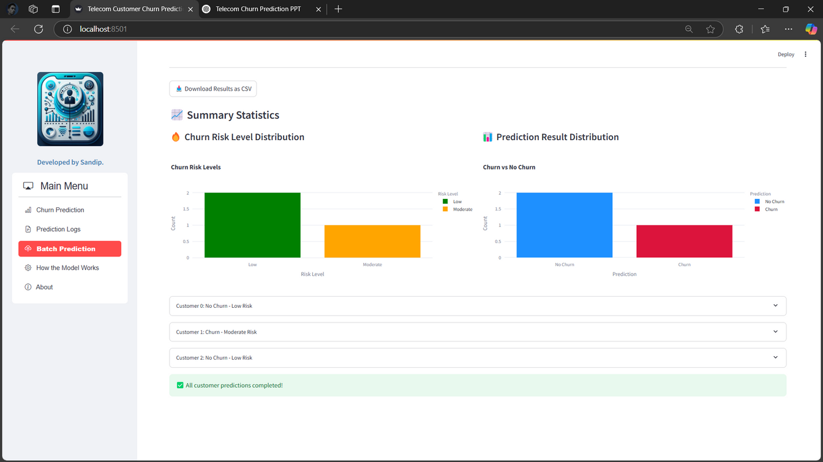
Batch Prediction:
Upload customer data in bulk for batch churn prediction.

Slide 29
Conclusion & Future Scope
Conclusion
Developed an end-to-end churn prediction system for the telecom industry using machine learning.
Achieved reliable performance using models like Random Forest, XGBoost, and an ensemble Voting Classifier.
Deployed a user-friendly Streamlit app supporting real-time and batch predictions.
Identified key churn indicators such as tenure, monthly charges, and lack of support services.
Future Scope
Integrate Deep Learning models for improved temporal pattern detection.
Enable automated retraining with live data streams.
Integrate with CRM systems for real-time customer retention strategies.

Slide 30
Thank you.

